Slide 1
Surviving the Tech Turmoil: Can Companies Dodge the Layoff Trend?
Group 2: Cassandra, Cody, Abdul, Dylan, Casey, and Shan

Slide 2
CONTENTS
Introduction
Industries most affected by layoffs
Companies with the most layoffs
Company maturity and its effects on layoffs (Funding Stage)
Summary

Slide 3
INTRODUCTION
‘Surviving the Tech Turmoil' will analyze the impact of layoffs on the tech industry. Discover which companies and sectors have been hit hardest and learn about the relationship between the maturity, funding stage, and vulnerability to layoffs.

Slide 4
Sourcing
The data for our project was sourced from a comprehensive dataset on tech layoffs from 2020 to 2024 available on Kaggle.com, a platform known for its reliable and extensive datasets used for analytical projects. We chose this dataset because it provides a detailed and quantifiable snapshot of the tech industry's workforce dynamics during a period of significant economic fluctuation. This data is crucial for our objective to explore the landscape of layoffs within the tech industry and understand the underlying trends and impacts.

Slide 5
Approach
Our research focused on three key areas: the hardest-hit industries, the companies with the most layoffs, and how company funding stages affect layoffs. We narrowed our data to USA firms for consistency and conducted a thorough initial analysis to eliminate anomalies. After refining the dataset for accuracy, we standardized all records to ensure reliable insights.

Slide 6
Industries most affected by layoffs
Industries at the Epicenter

Slide 7
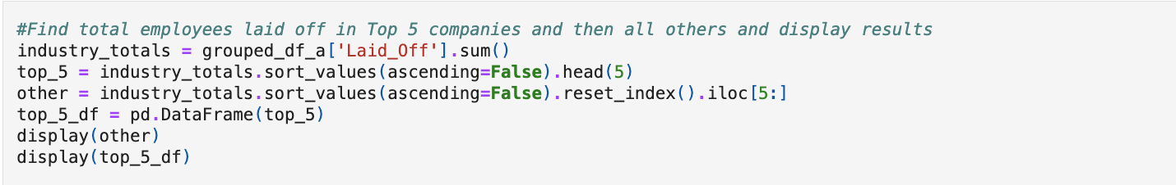
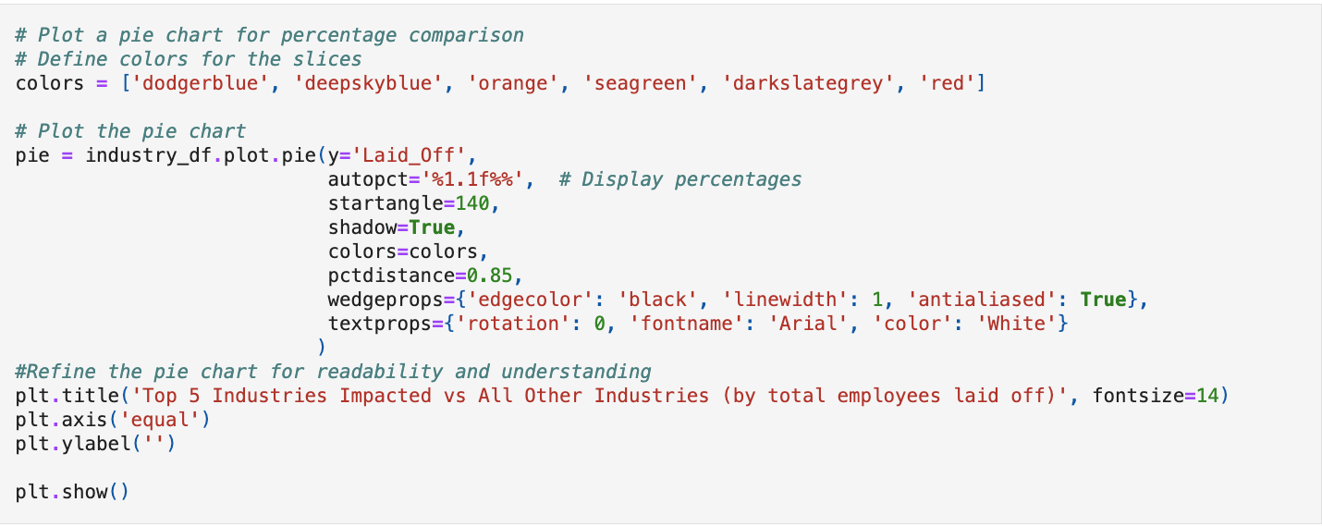
Code Used to clean up and filter Data

Slide 8
Top 5 Industries Impacted vs. All Other Industries (by total employees laid off 2020- 2023)
Notes:
We will begin by examining the distribution of layoffs across different industries. Notably, the top 5 industries collectively account for more than half of the layoffs, specifically 56%, reflecting a significant concentration of workforce reductions in these sectors.
Delving deeper, the Consumer industry emerges as the most affected sector, bearing 18% of the total layoffs. This figure is particularly impactful, representing nearly a fifth of the layoffs over the last four years, and it speaks to broader economic challenges and shifting consumer behavior impacting the sector.
Beyond the top 5, the layoff landscape is diverse. 27 other industries make up the remaining 44% of the layoffs. This indicates the widespread impact of layoffs across various sectors, showing that market dynamics and industry-specific factors are far-reaching.

Slide 9
Total Laid Off Employees by Industry(2020-2024)
Notes:
Let's focus on the consumer industry, which tops the layoff charts with a staggering 50,217 layoffs. This sector, along with Other categories and Transportation, leads in the number of job cuts. These figures are not just numbers; they represent the significant challenges and shifts within these sectors.
The trend within the consumer industry unveils the profound negative impacts of the COVID-19 pandemic. The layoffs mirror the disruptions in supply chains, changes in consumer spending habits, and the accelerated transition to digital services, which have necessitated a restructuring in workforce allocation.

Slide 10
Total Laid Off Employees by Industry(2020-2024)
Notes:
Let's examine the frequency of layoffs within the tech industry. By showing the total occurrences, we can see the industry's stability over time. The data we've gathered provides a detailed chronology of the layoffs, highlighting the variances from year to year.
A standout statistic from our timeline is that 2021 saw only nine layoffs in the tech industry. This number is significant as it indicates a period of relative stability or effective adaptation to the pandemic's initial economic impacts.
In stark contrast, 2022 experienced a surge, with over 350 layoffs the following year. This dramatic increase paints a picture of a sector grappling with ongoing challenges, possibly emerging from the pandemic's extended effects. It may have forced many tech companies to reevaluate and reduce their workforce substantially.

Slide 11
Companies with the most layoffs
A Rundown of Companies Facing the Largest Reductions

Slide 12
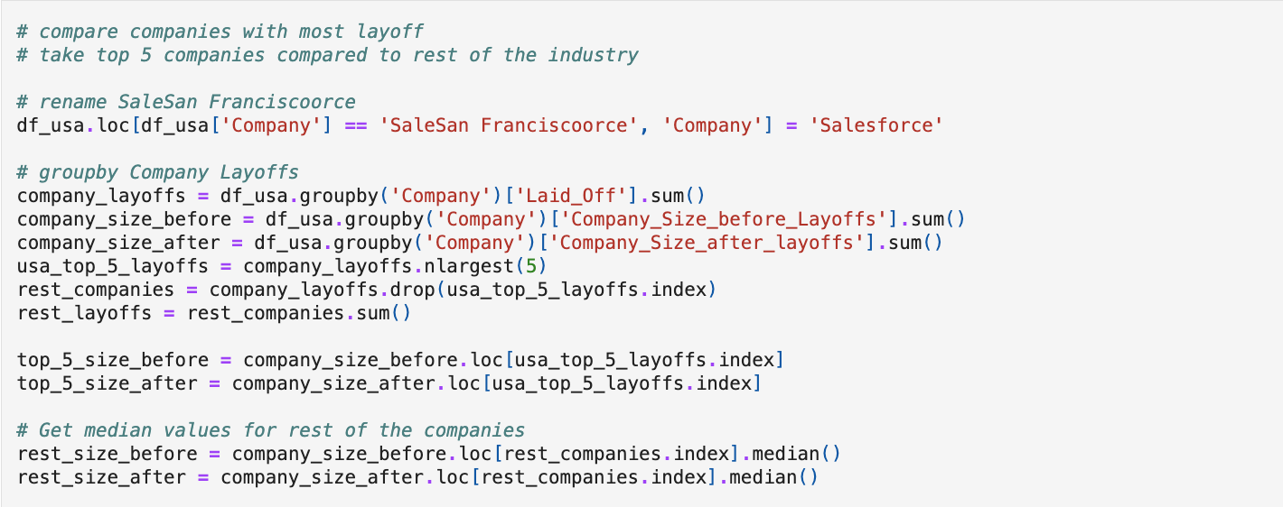
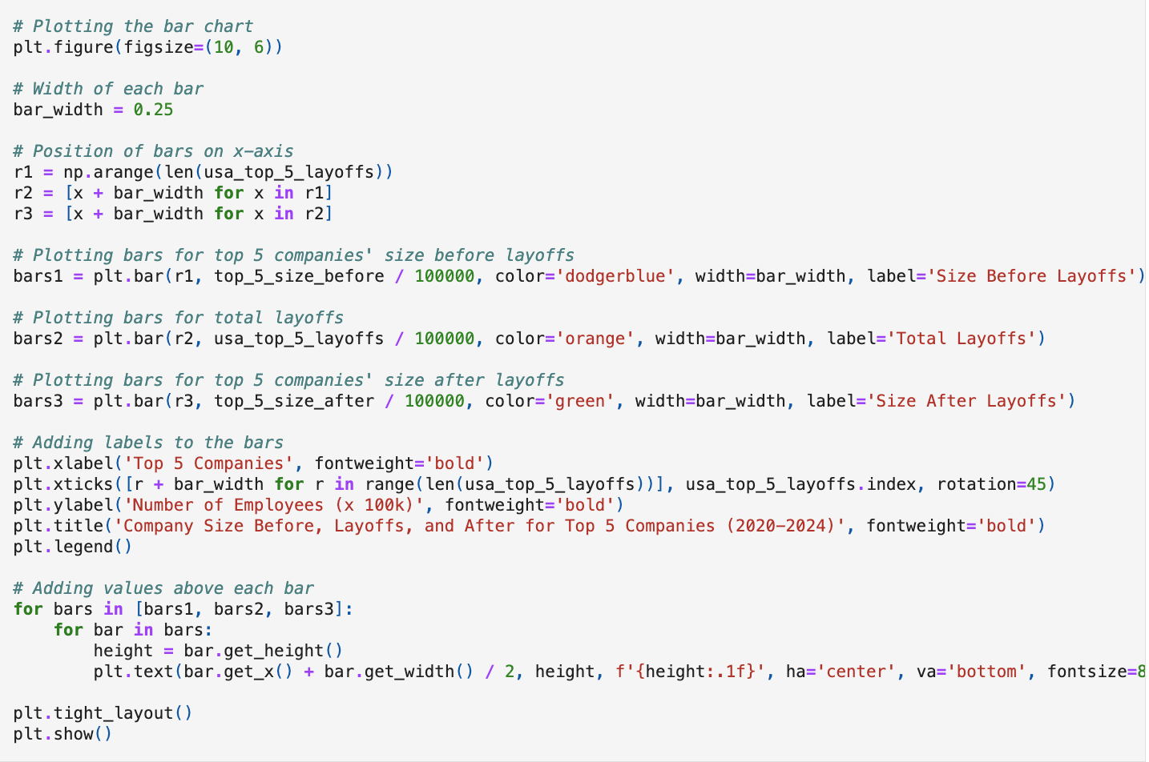
Significant sections of Code Used to filter and plot Data

Slide 13
Layoffs Comparison: USA Top 5 Companies vs Rest of Industry (2020-2024)
Notes:
This chart compares the top 5 tech companies and the broader industry, illustrating the total number of layoffs from 2020 to 2024. It highlights that the top 5 companies experienced a combined total of 81,150 layoffs, while the rest of the industry saw a significantly higher number at 192,831. This visual comparison not only underscores the scale of job cuts across the tech sector but also shows the distribution of layoffs between the industry's leading firms and the numerous other players.

Slide 14
Percentage Change in Workforce for Top Companies by year
Percentage Change in Workforce
Notes:
Our data analysis from 2020 to 2024 shows that despite being the smallest of the top 5 tech firms, Meta had the most significant percentage reduction in staff post-layoffs, indicating that workforce scale does not shield against substantial organizational change.

Slide 15
Company Size Before, Layoffs, and After for Top 5 Companies (2020-2024)
Number of Employees (x 10K)
Notes:
Our analysis of the top 5 tech companies over 2020 to 2024, focusing on headcounts before and after layoffs, demonstrates contrasting impacts. Amazon's layoffs had a relatively minimal effect on its overall employee numbers, maintaining a robust headcount despite industry trends. In stark contrast, Meta experienced a more pronounced reduction in staff numbers, underscoring how layoffs can differentially affect companies depending on their operational and strategic frameworks.

Slide 16
Company maturity and its effects on layoffs (Funding Stage)
Does Maturity Influence Stability?

Slide 17
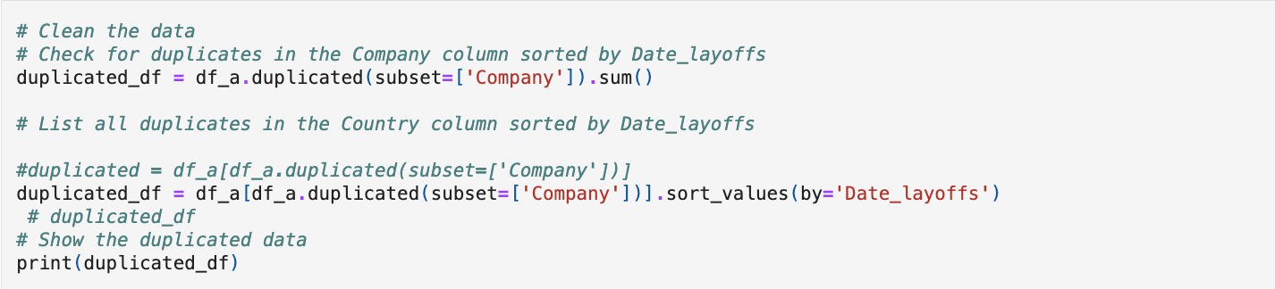
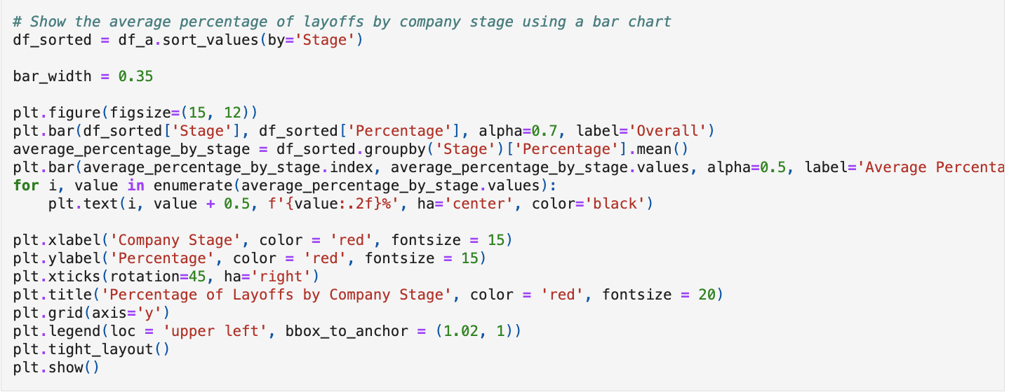
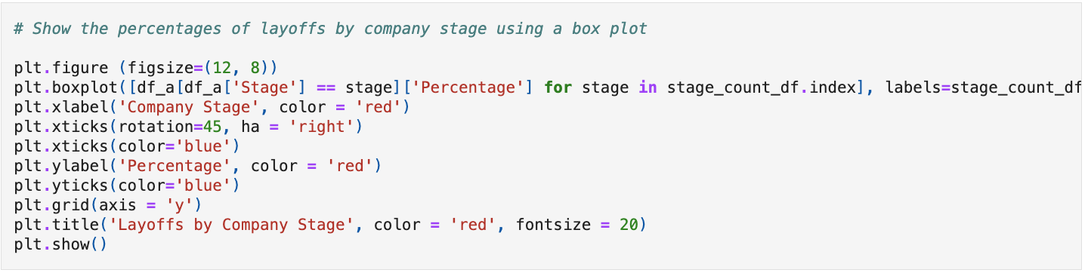
Significant sections of Code Used to Clean and plot Data

Slide 18
Layoffs by Company Stage
Notes:
This chart shows layoffs based on company funding stages. Post-IPO companies lead in layoffs, likely due to the pressures of public markets and their larger size. Series B and C companies follow, reflecting the challenges they face in scaling and market adaptation during these growth phases.

Slide 19
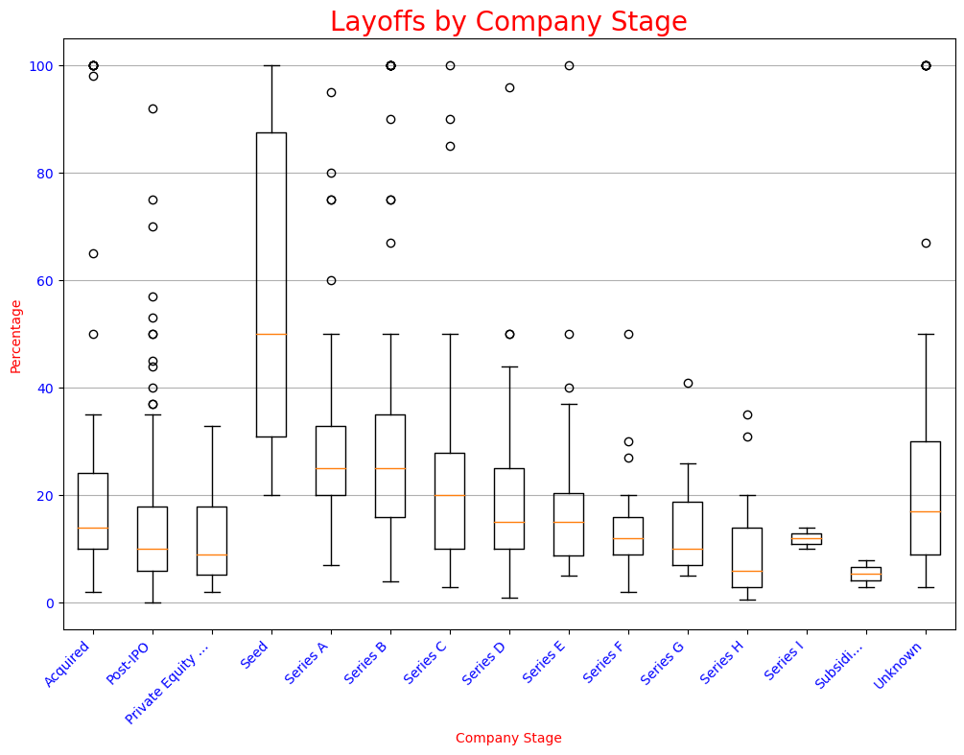
Show the percentages of layoffs by company stage
Notes:
To visualize the impact of layoffs across different company stages from 2020 to 2024, we meticulously filtered our dataset to isolate the percentage of layoffs at each stage of company growth. This selective process allowed us to construct a box plot chart delineating the range and median layoff percentages from early-stage startups to well-established corporations. The resulting chart reveals how various stages of company maturity weathered the layoff storm during this period.

Slide 20
Percentage of Layoffs by Company Stage
Notes:
The Post-IPO companies had the largest number of layoffs, but not the largest percentage. Seed-stage funded and start-up companies were disproportionately affected over the last four years.

Slide 21
conclusion
Our analysis underscores a fundamental reality: no tech company is shielded from the possibility of layoffs; they are a consequential facet of the industry's rhythm, influenced by the natural ebb and flow of business cycles, market trends, and the relentless pace of innovation. By examining the data across various sectors, company sizes, and stages of funding maturity, we gain insight into the myriad of factors that can precipitate workforce adjustments. By understanding these dimensions—industry conditions, organizational growth phases, and financial stability—we can better comprehend the layoff landscape within the tech ecosystem.

Slide 22
THANK YOU
Group 2:
Cassandra, Cody, Abdul, Dylan, Casey, and Shan

